Slide 1
COMPUTER NETWORK

Slide 2
AGENDA
Computer network
Wan.man.lan.pan
Hardware
network connecting device
Network topology
Software
OSI MODEL
TCP/IP protocol
Window network command

Slide 3
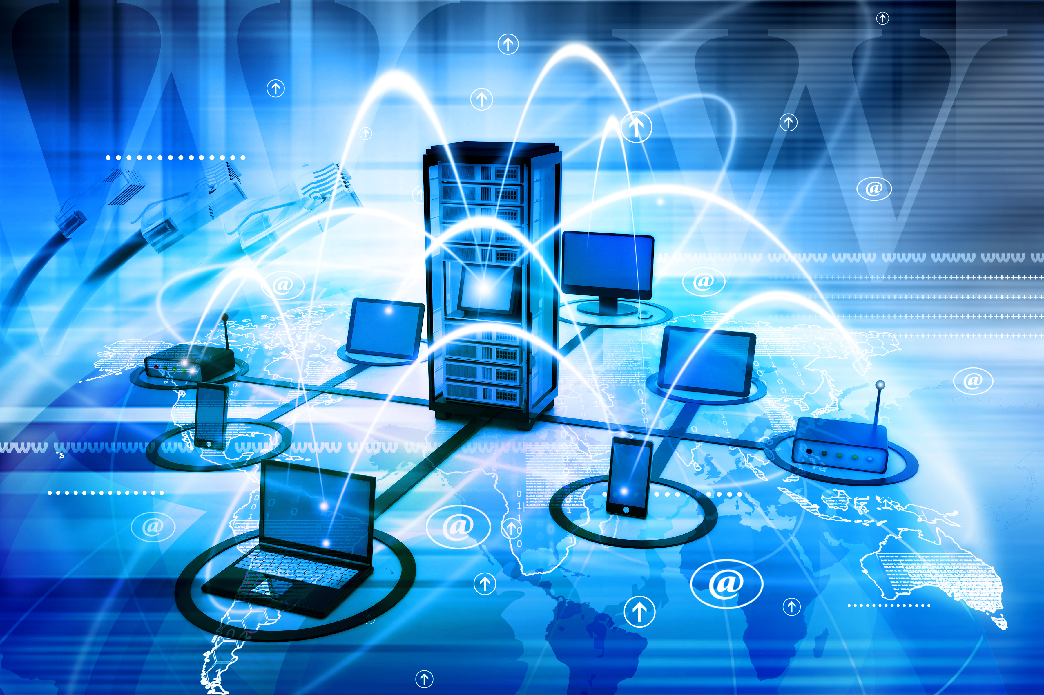
COMPUTER NETWORK
Computer networking
refers to interconnected computing devices that can exchange data and share resources with each other. These networked devices use a system of rules, called communications protocols, to transmit information over physical or wireless technologies.

Slide 4
HARDWARE: NERTWORK CONNECTING DEVICE
L1 devices: repeater hub
L2 devices: bridge switch
L3 devices: router L3 – switch;L3 ASIC + L2 switch
L4 devices:
L7 devices:

Slide 5
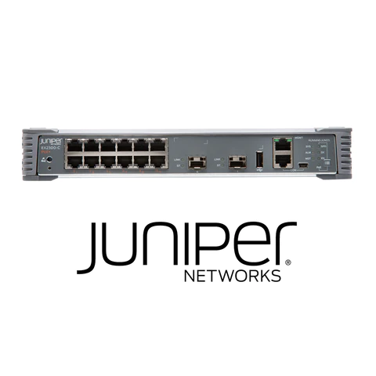
SWITCH VLAN

Slide 6
VLAN VIRTUAL LOCAL AREA NETWORK
Any broadcast domain that is divided and isolated in a computer network at the data connection layer is known as a virtual local area network (VLAN) (OSI layer 2). [2] [3] A physical object that has been replicated and changed by additional logic within a local area network is referred to in this context as virtual. In order to create the look and functioning of network traffic that is physically on a single network but behaves as though it is split between several networks, VLANs work by attaching tags to network frames and processing these tags in networking systems. Despite being connected to the same physical network, VLANs can maintain network application separation without the deployment of additional sets of cabling and networking hardware.

Slide 7
NETWORK TOPOLOGY
The configuration of a communication network's components—links, nodes, etc.—is known as its topology. Network topology is a term used to define or explain the configuration of many forms of telecommunication networks, such as computer networks, industrial fieldbuses, and command and control radio networks.
The topological structure of a network is known as network topology, and it can be represented physically or conceptually. It is a graph theory application[3] where connecting devices are modeled as links or lines between the nodes, and communicating devices are modeled as nodes. Physical topology refers to where different network elements are located (such as device placement and cable installation), whereas logical topology shows how data moves throughout a network. Even if two networks may have different node distances, physical connections, transmission speeds, or signal kinds, their logical topologies might be the same. The physical layer of the OSI model is particularly interested in the physical topology of a network.

Slide 8
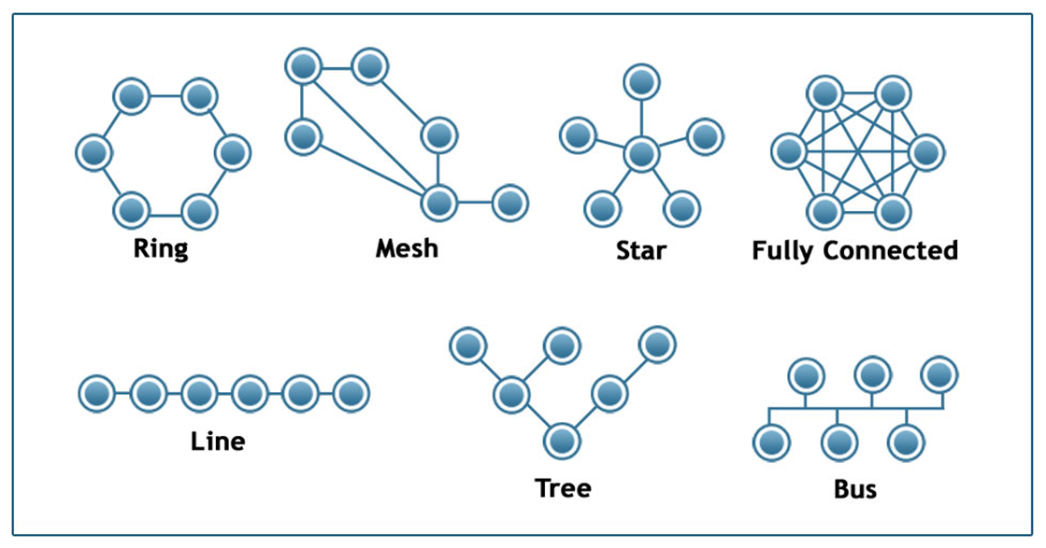

Slide 9
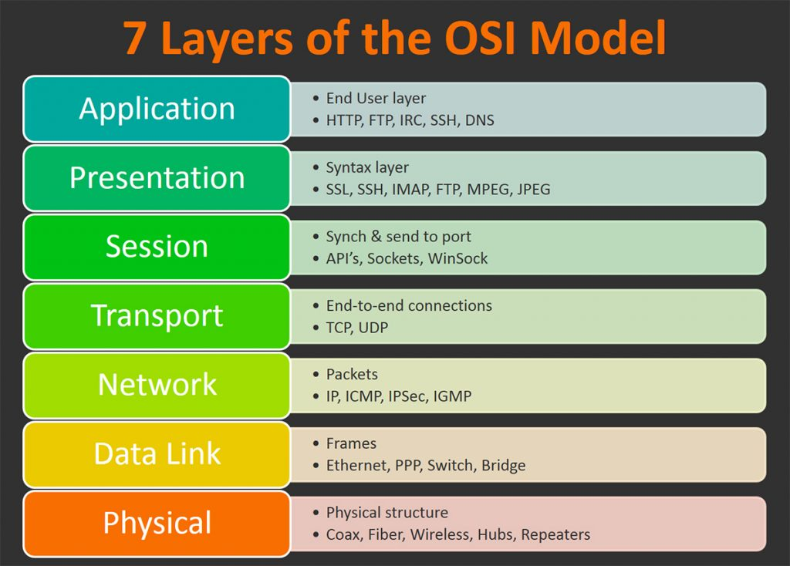
OSI MODEL

Slide 10
Mesh ‘LAN local area network

Slide 11
COMPUTER NETWORK:SOFT WARE

Slide 12
PHYSICAL

Slide 13
TCP/ICP PROTOCOL SUITE
PICTURE

Slide 14
HTTPS

Slide 15
COMPUTER NETWORK: WINDOW COMMAND

Slide 19
IP CONFIG
NESTRAT
PING

Slide 20
COMPUTER NETWORK

Slide 21
SCENARIO

Slide 22
Tools nestat + task manager + taskkill

